Slide 1
SECURE DATA HIDING IN IMAGE USING STEGANOGRAPHY
CYBERSECURITY PROJECT
Presented By:
Student Name : KAMESWARI CHAMARTHI
College Name & Department : INSTITUTE OF AERONAUTICAL ENGINEERING, HYDERABAD;
Department: CSE (CYBERSECURITY)

Slide 2
OUTLINE
Problem Statement
Technology used
Wow factor
End users
Result
Conclusion
Git-hub Link
Future scope

Slide 3
Problem Statement
Hide a secret message inside an image by modifying its pixel values. Encrypt the message using a passcode to prevent unauthorized access. Save the modified image without affecting its visibility. Retrieve and decrypt the hidden message only if the correct passcode is provided. Ensure the image file path is correct and prevent data loss during encryption.

Slide 4
Technology used
Technologies Used:
Programming Language: Python
Library: OpenCV (cv2)
IDE: Visual Studio Code (VS Code)
Operating System: Windows/Linux
Hardware Requirement: 4GB RAM (minimum)

Slide 5
Wow factors
Steganography in Action: Hides a secret message inside an image without making visible changes.
Passcode-Protected Encryption: Only users with the correct passcode can decrypt and retrieve
the hidden message.
Lightweight & Fast: Works efficiently even on low-end systems with just 4GB RAM.
Cross-Platform Compatibility: Runs on both Windows and Linux without major modifications.
Simple Yet Effective: Uses basic Python and OpenCV functions for easy understanding and customization.
Image Integrity Preserved: The modified image still looks the same to the human eye, ensuring stealth.
Expandable & Upgradable: Can be improved with advanced steganography techniques (LSB, DCT, etc.)
in the future.

Slide 6
End users
End Users:
Cybersecurity Enthusiasts – Individuals interested in learning about steganography and data hiding
techniques.
Forensic Experts – Investigators who need to analyze or embed hidden messages in images
for secure communication.
Privacy-Conscious Users – People who want to send secret messages without detection.
Developers & Researchers – Those exploring image processing, encryption, and steganography
for advanced applications.
Students & Educators – Learners and teachers using the project for educational purposes in cybersecurity
and cryptography.

Slide 7
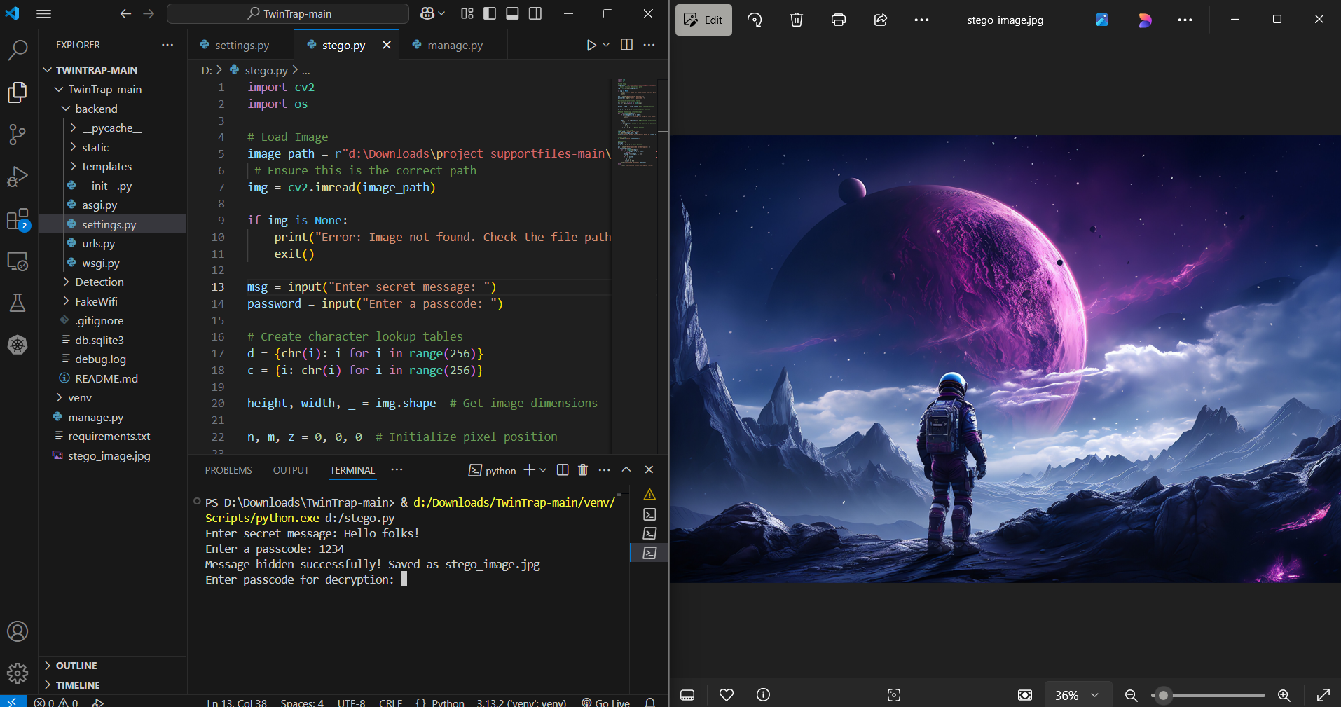
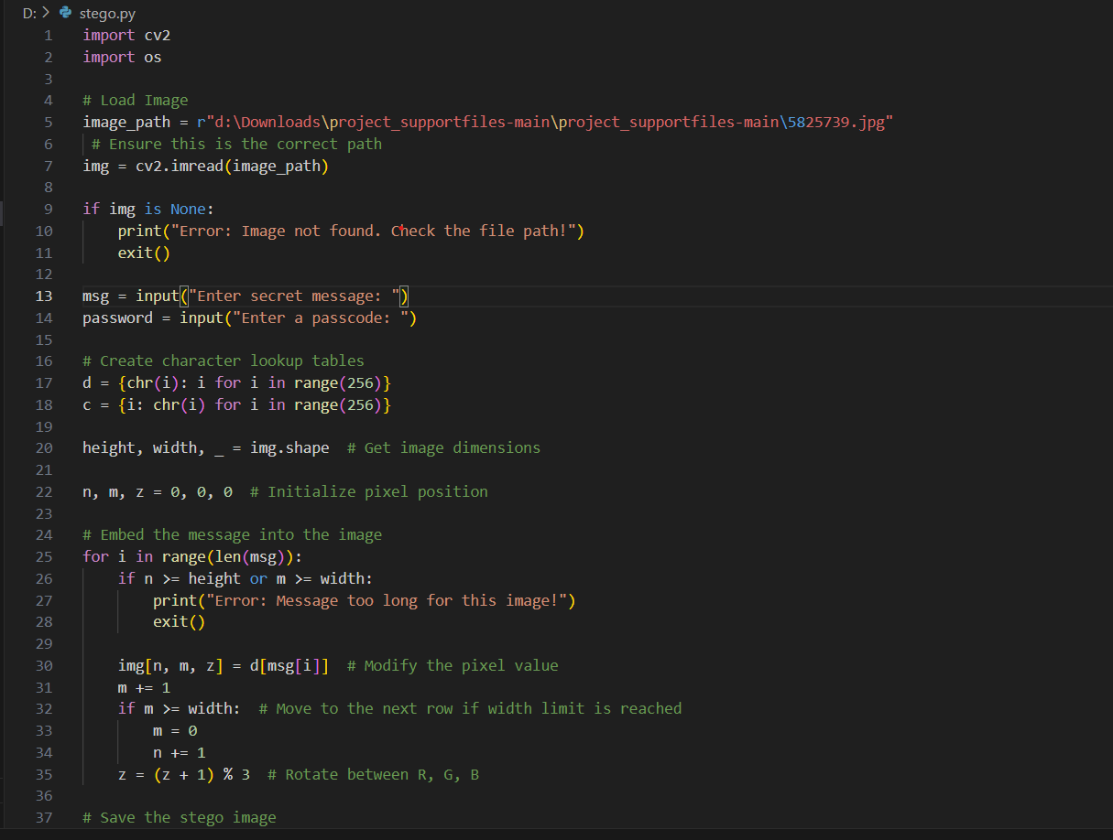
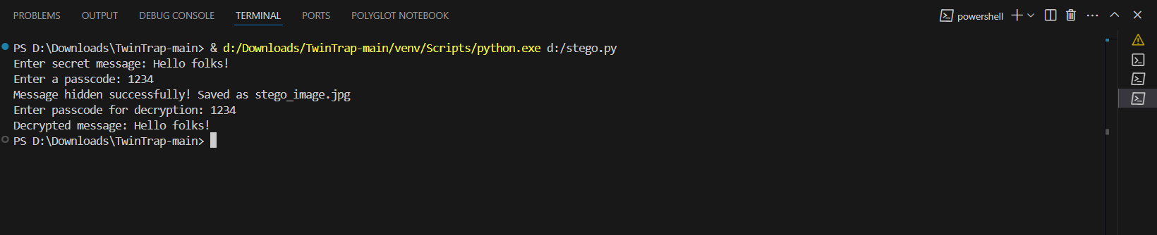
Results

Slide 8
Conclusion
This project successfully implements image-based steganography using Python and OpenCV, allowing users to
securely hide and retrieve messages within an image. With passcode protection, it ensures that only authorized
users can decrypt the hidden data. The lightweight nature and cross-platform compatibility make it accessible to
a wide range of users, from cybersecurity enthusiasts to forensic experts. This project can be further enhanced with
advanced encryption techniques for stronger security, making it a practical tool for secure communication and
data protection.

Slide 9
GitHub Link
https://github.com/KameswariChamarthi/AICTE_CS_Internship2025.git

Slide 10
Future scope
Advanced Steganography Techniques – Implement LSB (Least Significant Bit),
DCT (Discrete Cosine Transform), and AES encryption for enhanced security.
Support for Multiple File Formats – Extend compatibility to PNG, BMP, and GIF images for better quality
and flexibility.
Steganalysis Resistance – Improve the algorithm to avoid detection by steganalysis tools and security
software.
Mobile & Web Integration – Develop an Android/iOS app or a web-based platform for easy access and
usage.
Cloud-Based Secure Storage – Enable secure cloud storage and retrieval of steganographic images
for remote access.
Increased Data Capacity – Optimize encoding methods to hide larger messages without affecting
image quality.
AI-Powered Detection & Prevention – Implement machine learning to detect and prevent unauthorized
steganography usage.

Slide 11
THANK YOU

